Slide 1
Your expressway
to invaluable experience
and skills!
POWERED BY MACRIX.EU
3 months development program for students, willing to start their career in IT!
WWW.YPPMACRIX.EU

Slide 2
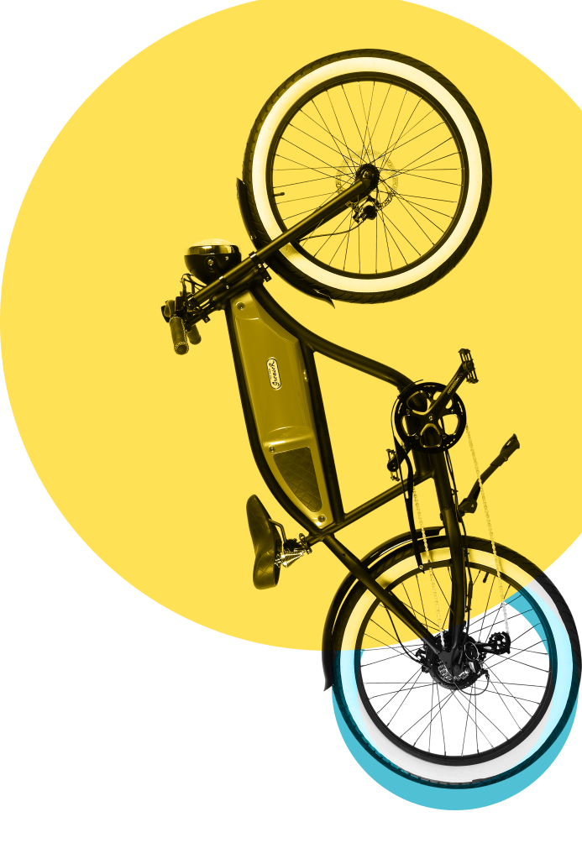
WHAT IS
YOUNG POTENTIALS PROGRAM?
The Young Potentials Program is a golden ticket for students and recent graduates under 26. Over the course of three months, participants undergo intensive training in software development and work on real-world projects.
Whole Program is lead in Learn & Stay formula, that means that the best trainees will get job proposal.
WHO CAN PARTICIPATE
IN THE PROGRAM?
STEM (science, technology, engineering, mathematics) students and recent graduates aged 18 – 26 years
Unapologetically ambitious go-getters willing to start their career in IT
English language skills: B2/C1 level

Slide 3
WHAT MAKES YPP SO UNIQUE COMPARED TO ANOTHER DIFFERENT PROGRAMS?
We created a development program for the student that we ourselves would like to participate in. Some of us remembered days, when internships were unpaid, when young developers were left on their own, without the support of much more experienced people. And there were no future for trainees after internship.
That’s why we decided to change that and do our part to make a difference!

Slide 4
YOUNG POTENTIALS PROGRAM IS A UNIQUE OPPORTUNITY FOR YOU, BECAUSE:
Development / Growth
You will develop your competencies, in a dynamic work environment under the guidance of professionals. We put a lot of heart and know-how into our program, more than six months of preparation and 3 months of testing, so that learning takes place in a structured, logical way. Take advantage from our experience and proven ways to improve your own skills.
IT Projects
Young Potential Program is powered by Macrix Technology Group. Which means that projects You will be working to cover different fields such as: custom software development for our Clients, industrial automation, digital transformation, cloud development or even embedded systems. How does it sound for You?
Mentroship / Feedback
Development occurs in a culture of self-respect and openness to testing and making mistakes. So we set up Academy Coaches - mentors who will watch over your development. As feedback culture is in our DNA, during the program You'll have regular scheduled feedbacks ( with your project team leader and with the HR department), so that your learning comfort is taken care of.

Slide 5
YOUNG POTENTIALS PROGRAM IS A UNIQUE OPPORTUNITY FOR YOU, BECAUSE:
Hands-on approach
People learn new skills best when they have to implement them in real life. That’s why 70% time of Young Potential goes for solving the real business problems, alongside our developers, in a team. The rest 30% of the whole Program covers solid theory needed to become successful junior software developer. This hands-on approach 70% for practice, 30% for solid theory results in better consolidation of knowledge. As Stephen Hawking said:
“The greatest enemy of knowledge is not ignorance, it is the illusion of knowledge.” -Stephen Hawking
{Learn & Stay} formula
The secret of our learn & stay formula is simple: We give you the tools, access to experienced people in the industry, our know-how, all to unlock your potential and create for You possibility of getting a permanent job offer.
You have already learned the necessary theory, used the time to implement it practically in projects. Now it's time for the final task, assessing your potential and the possibility of getting a permanent job offer: the final project: 2 weeks to complete the task that will give you a bright future in IT!
The decision to make a job offer is made on the basis of comprehensive factors such as: results from feedback, ability to learn quickly , commitment, problem-solving skills, quality of the final project delivered.
All in your hands, or under your fingers on the keyboard. Go-get it.

Slide 6
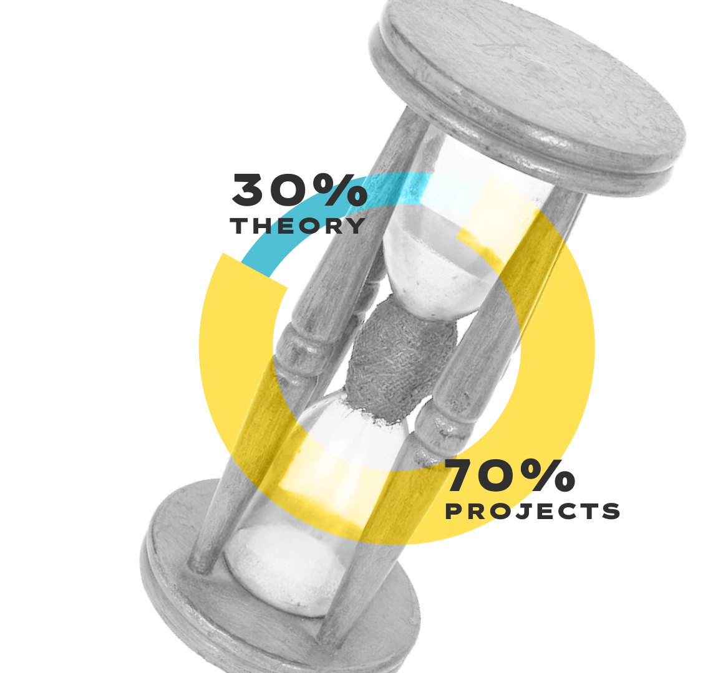
WHAT THEORY COVERS THE
TRAINING PART OF YPP
The goal of these trainings is to help participants develop the skills they need to be successful in software development. Trainings include variety of topics, such as:
Version Control System and Git
Agile and Scrum
OOP, SOLID and Design Patterns
Refactoring and Clean Code
Dependency Injection
ASP.NET and Web API
Angular, React and Blazor
Database and Entity Framework
Unit Testing
CI/CD
ProconTEL Framework
UI Design Patterns
Parallel and Async Programming

Slide 7
SUMMING UP, YPP IS YOUR
OPPORTUNITY TO:
gain valuable experience,
develop new skills,
network with like-minded peers and experienced developers
build a portfolio of real projects and set themselves on the path to success in their career.

Slide 8
HOW CAN I APPLY?
HOW THE RECRUITMENT
PROCESS LOOK LIKE?
All current information You will find here:
www.yppmacrix.eu
You will have two-steps recruitment process, which will consist of 2 parts: technical part and soft skills part.
WHEN THE NEXT YOUNG POTENTIALS PROGRAM IS STARTING
We are in the constant process of searching new talents, so simply apply!
Claudia Sójka
IT recruitment specialist

